Slide 1
Structures

Slide 2
Structures
Robotic Manipulator Selection
Extruder Mount

Slide 3
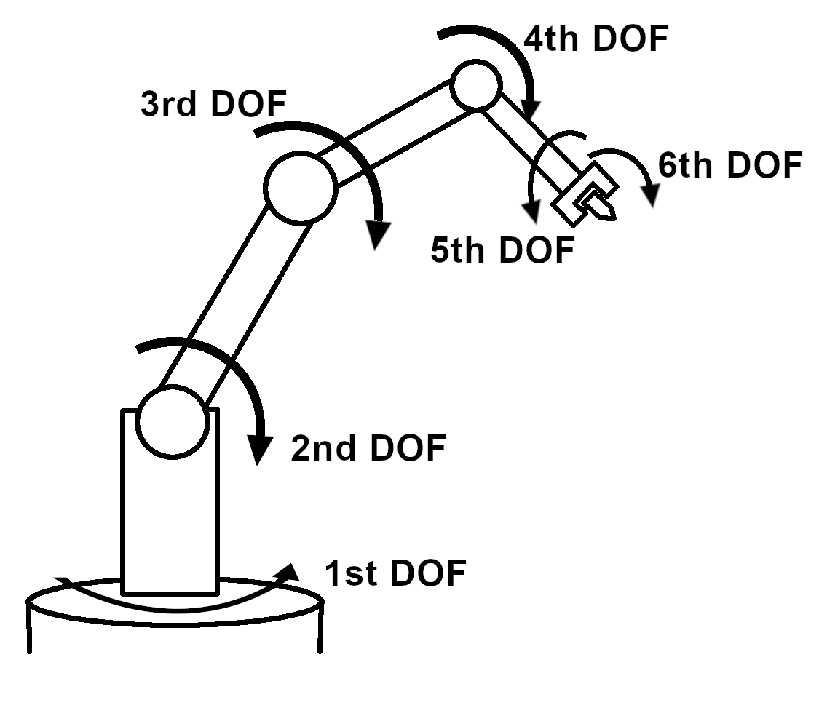
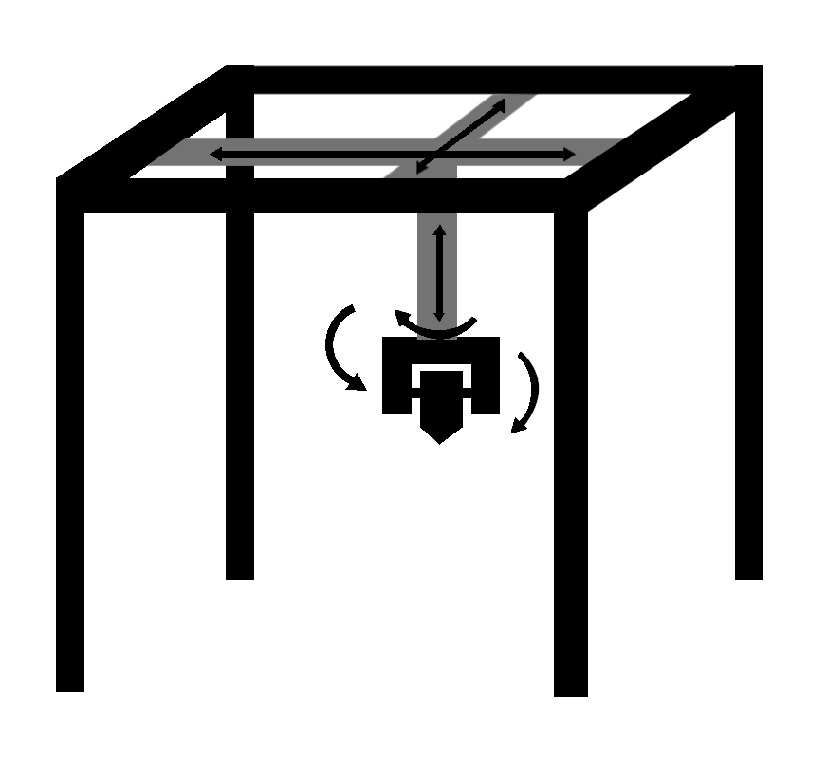
Robotic Manipulators
Robotic Arm
Traditional 3D Printer

Slide 4
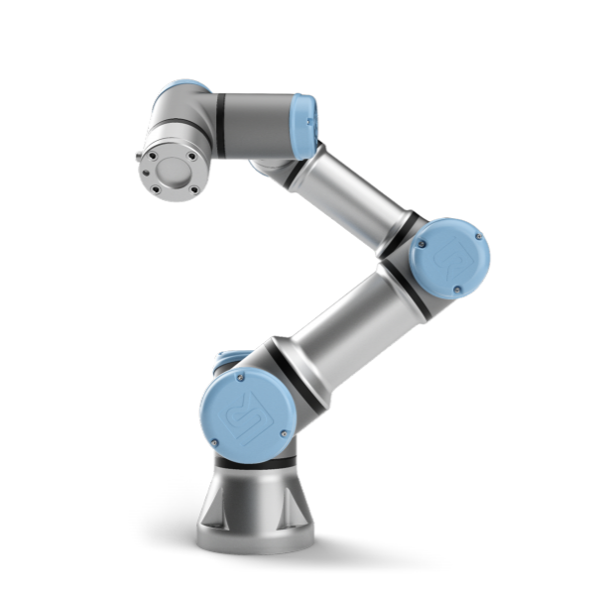
Universal Robotic Arms
UR3e model
3 kg payload
Six degrees of freedom
Pose Repeatability of ±0.03mm with payload
ROS-compatible
Notes:
https://s3-eu-west-1.amazonaws.com/ur-support-site/41166/UR3e_User_Manual_en_Global.pdf

Slide 5
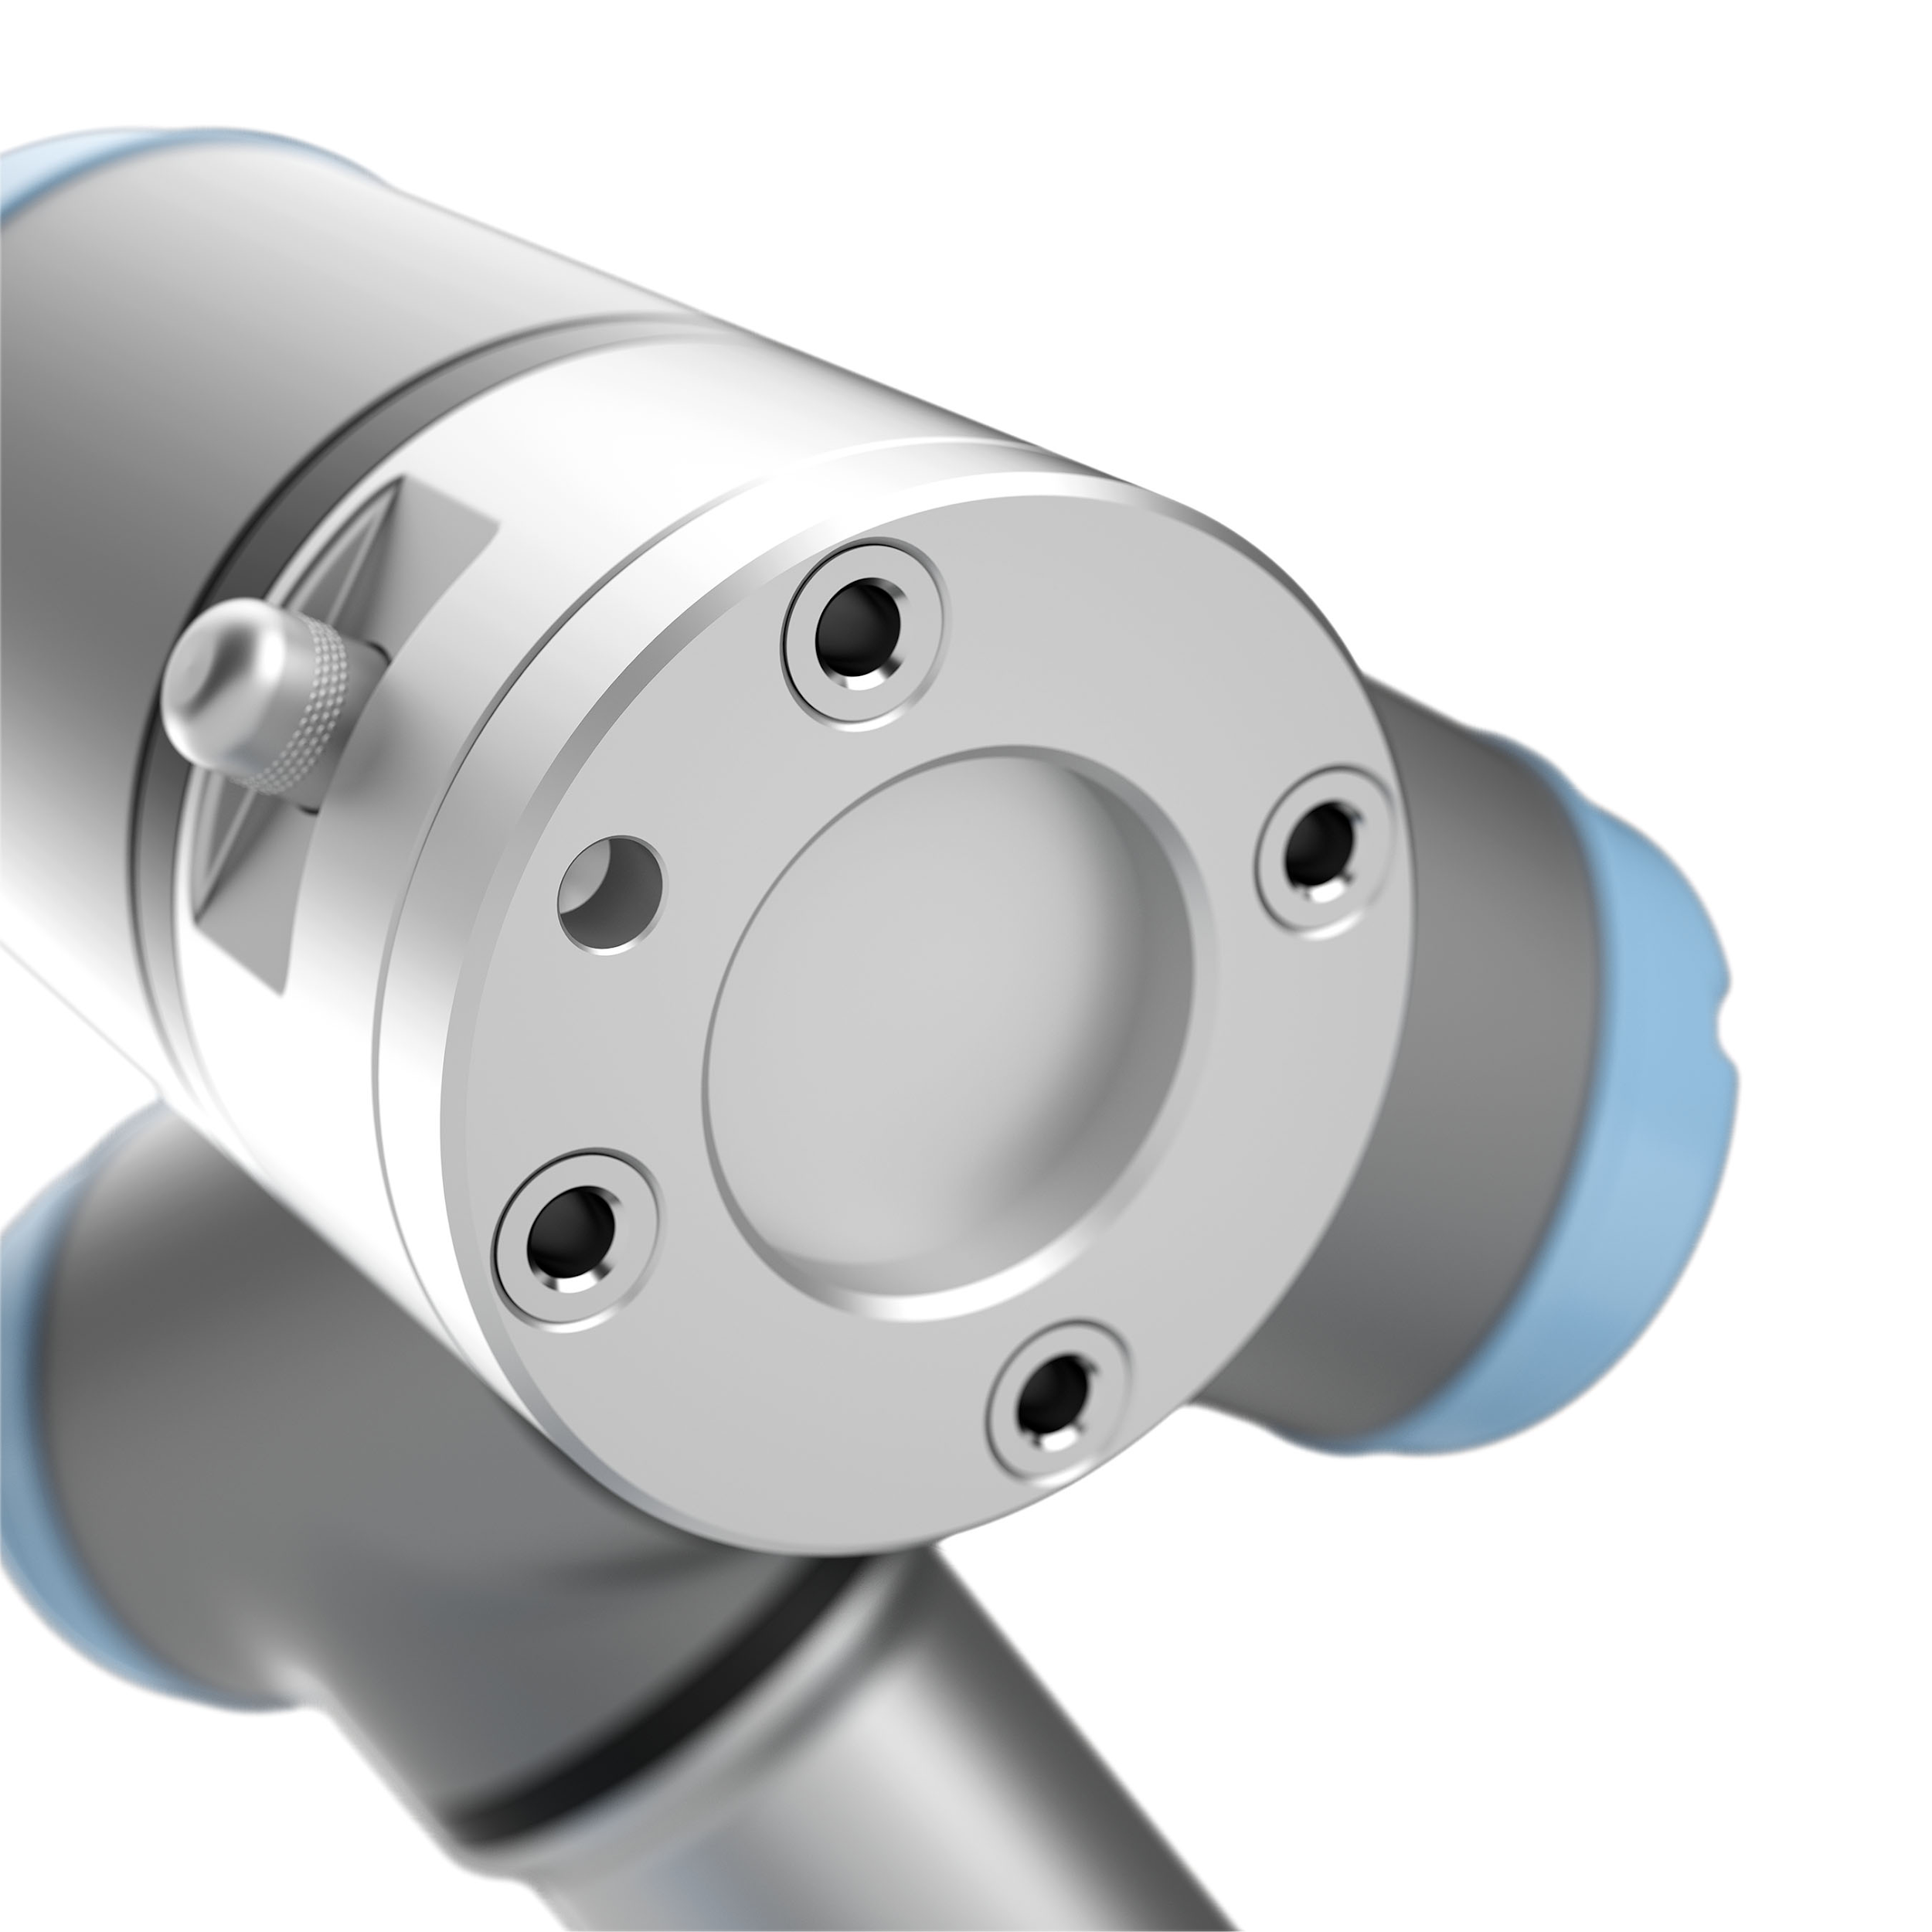
Mounting Extruder
ISO 9409-1-50-4-M6
8 pin connector provides 0V, 12V, or 24V
End Effector Mount will be made through 3D printing or CNC machine
Notes:
Picture: https://www.google.com/url?sa=i&url=https%3A%2F%2Fwww.scottautomation.com%2Fproducts%2Fur3e-universal-robot%2F&psig=AOvVaw14qEAmD2DmZgcuqONUZgHj&ust=1581541751705000&source=images&cd=vfe&ved=0CAIQjRxqFwoTCJD-0aS0yucCFQAAAAAdAAAAABAE

Slide 6
Structures Testing
Initial/Individual Tests:
Run simulations of movements using ROS
Test accuracy and precision of UR3e without mount attached
Test accuracy and precision with the mount attached
Test if mount can withstand temperatures from the hot end of 3D printer
Integration Tests:
Integrate mount and extruder
Print a small amount of layers on a flat surface
Print a curve on a vertical plane
Print on a similar 3D geometry to our goal print surface

